Slide 1
Work schedule.bat
ELEBC 2023 Jessy

Slide 2
Outline of bat
.bats’ number | Function | When to Work
01 | Input “radius”, “lat”, “lng” to OpenStreetMap API to get the amenities around the specific location. | Not scheduling now.
02 | Use API to get the Youbike2.0_data from Taipei city in every 15 mins. E.g. “15min_Youbike_cleaned.xlsx” | Every 15 mins
03 | Combine the “15min_Youbike_data excels” to “merged data.xlsx” by DAY. | Every day 00:05
04 | Compute the former day EV by “merged data.xlsx” | Every day 00:10
05 | Compute everyday AC & PV by “0015 Youbike_cleaned.xlsx” | Every day 00:20
06 | Compute former day SV, CV, SPI, CPI based on 04&05. The columns of EVM file are EV, AC, PV, SV, CV, SPI, CPI. | Every day 00:25
07 | Update the EVM file in the former day to Google sheet connected to the Power BI. | Every day 00:35

Slide 3
Run02.bat
Use API to get the Youbike2.0_data from Taipei city in every 15 mins
Output file example: 2024-04-24 1115_Youbike_cleaned.xlsx

Slide 4

Run02.bat(0)

Slide 5
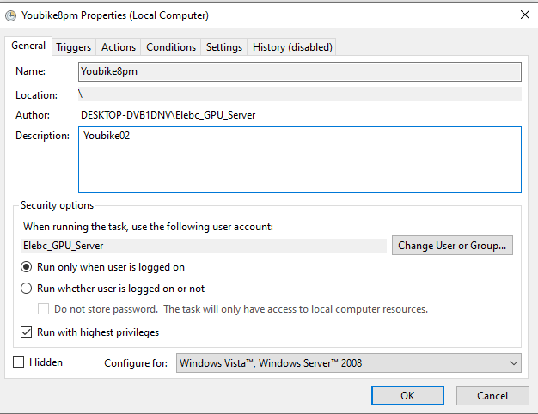
Run02.bat (1)

Slide 6
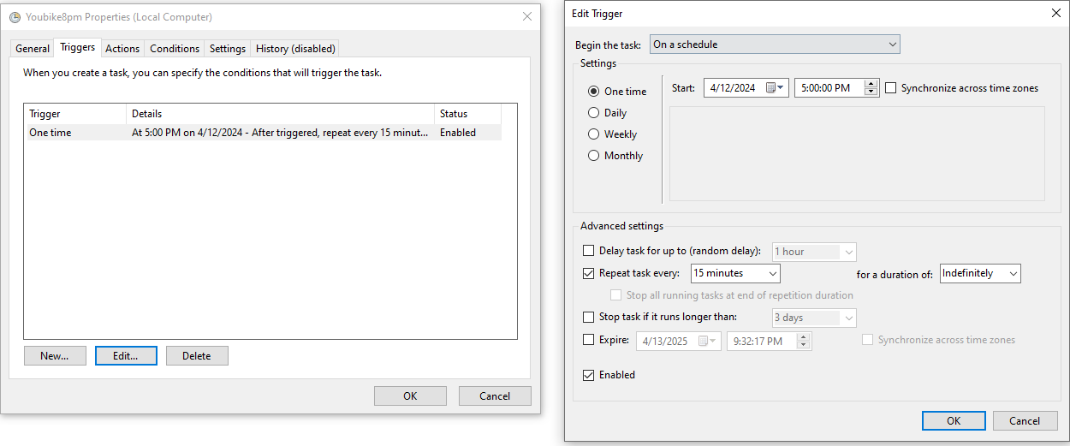
Run02.bat (2)

Slide 7
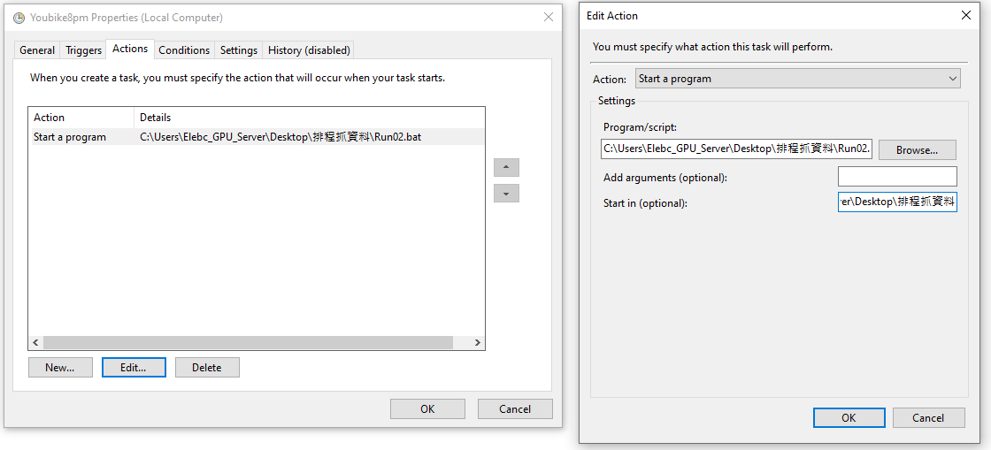
Run02.bat (3)
Start in C:\Users\Elebc_GPU_Server\Desktop\排程抓資料

Slide 8
Run03.bat
Combine the Youbike_15mins_data excels to merged data by DAY.
Select column [“bemp”].
Output file example 2024-04-23 merged_data.xlsx

Slide 9

Run03.bat (0)

Slide 10
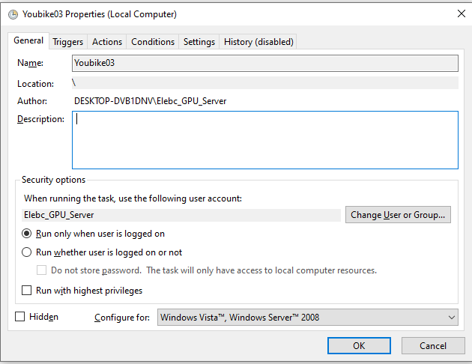
Run03.bat (1)

Slide 11
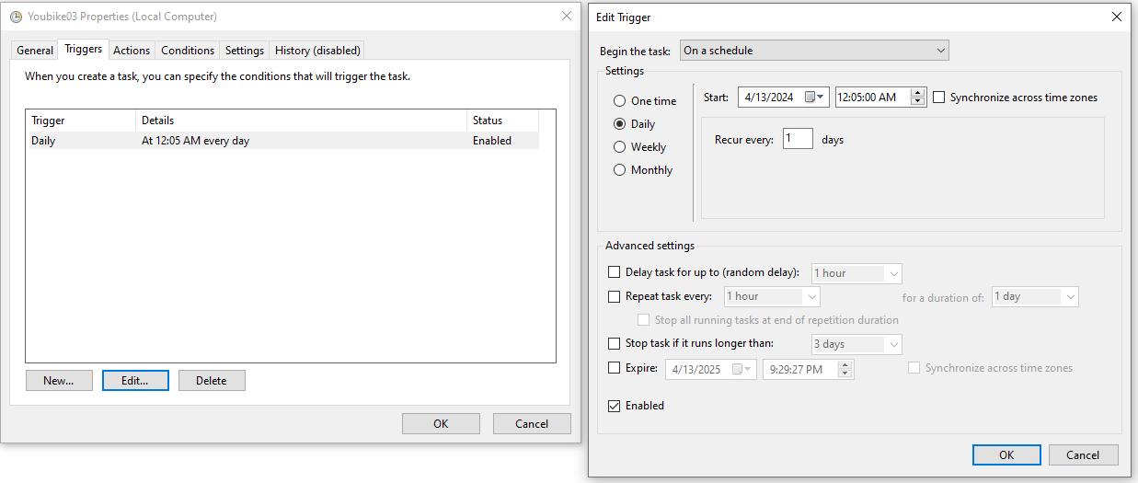
Run03.bat (2)

Slide 12
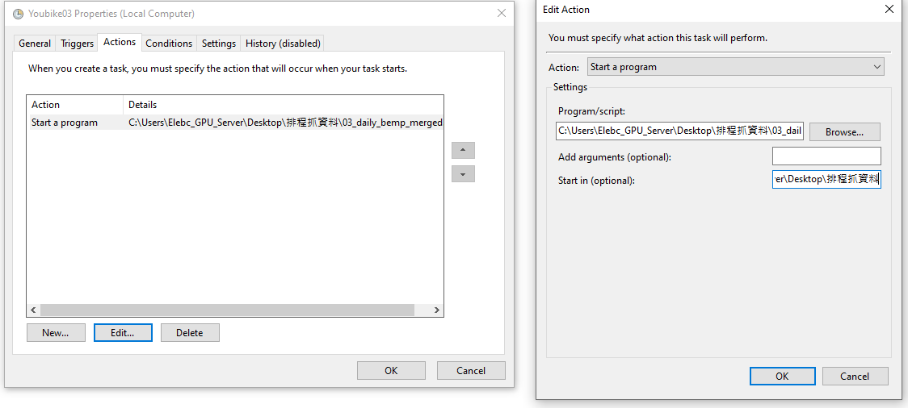
Run03.bat (3)
Start in: C:\Users\Elebc_GPU_Server\Desktop\排程抓資料

Slide 13
Run04.bat
Compute the former day’ EV by “merged data.xlsx”
Output file example 2024-04-23 EV.xlsx

Slide 14

Run04.bat (0)

Slide 15
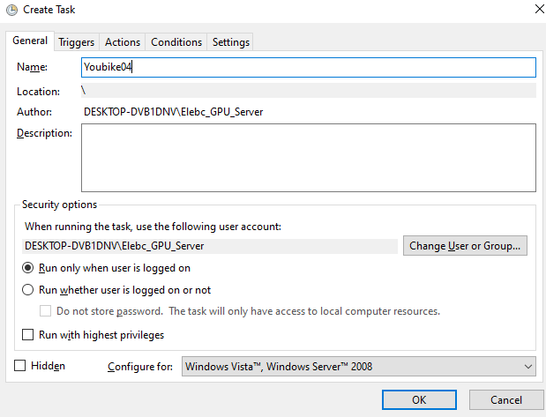
Run04.bat (1)

Slide 16
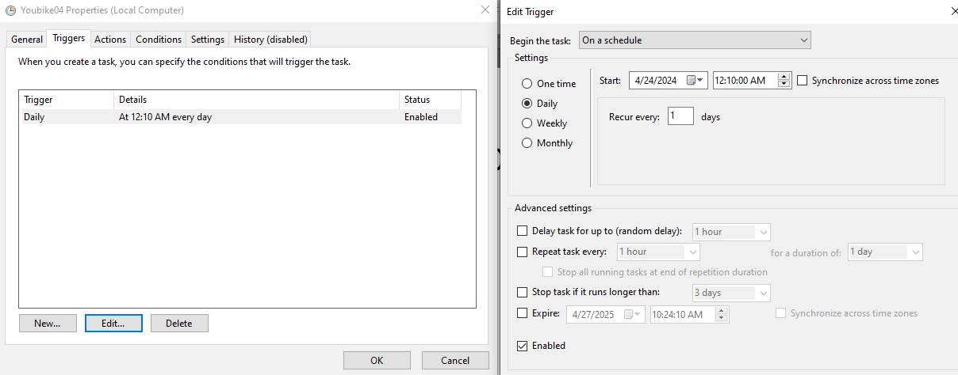
Run04.bat (2)

Slide 17
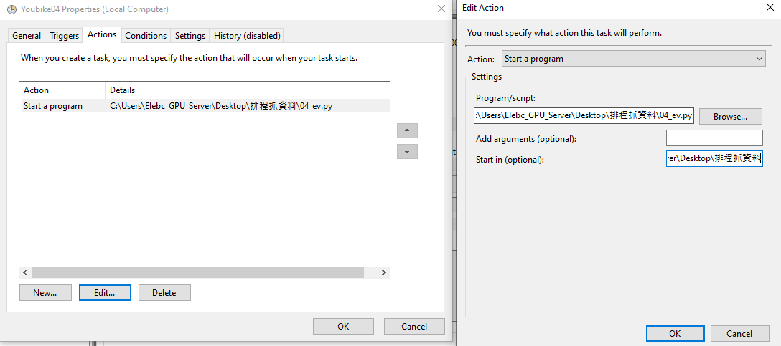
Run04.bat (3)

Slide 18

Run05.bat
To be based data with ['sno','sna',"sarea","ar","lat","lng",'tot','infoDate']+[“AC”,”PV]
Compute the everyday AC & PV by “0015 Youbike_cleaned.xlsx”
Output file example 2024-04-23 AC_PV.xlsx

Slide 19

Run05.bat(0)

Slide 20
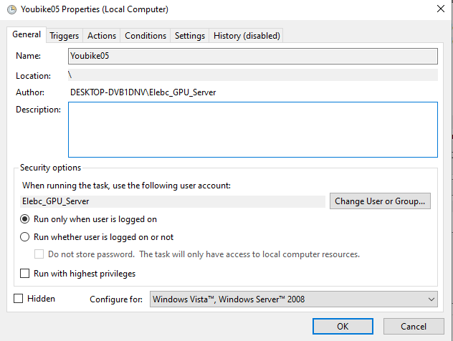
Run05.bat(1)

Slide 21
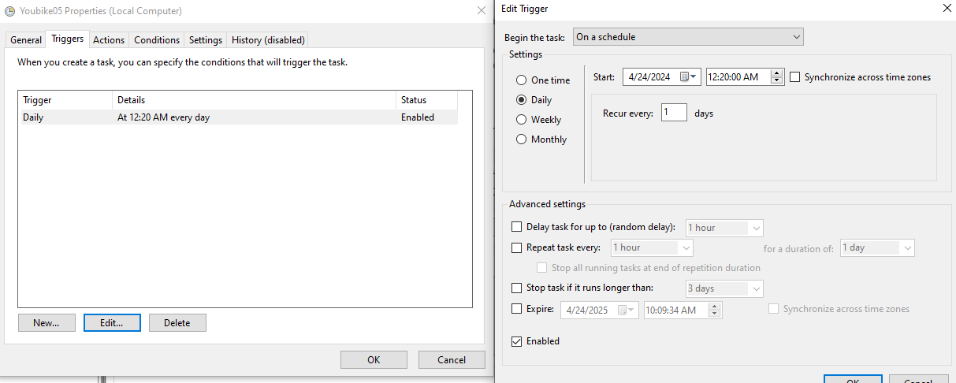
Run05.bat(2)

Slide 22
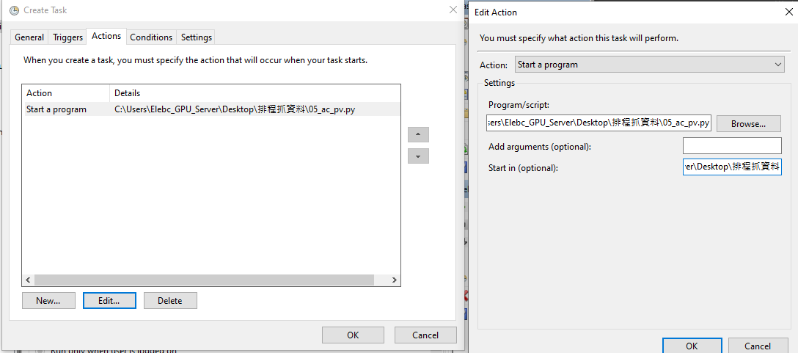
Run05.bat(3)

Slide 23
Run06.bat

Slide 24
Run07.bat

Slide 25
Some weird ERRORs, we lossed the data…
2024/04/16
2024/04/17
2024/04/24

